Slide 1

El Niño

Slide 2
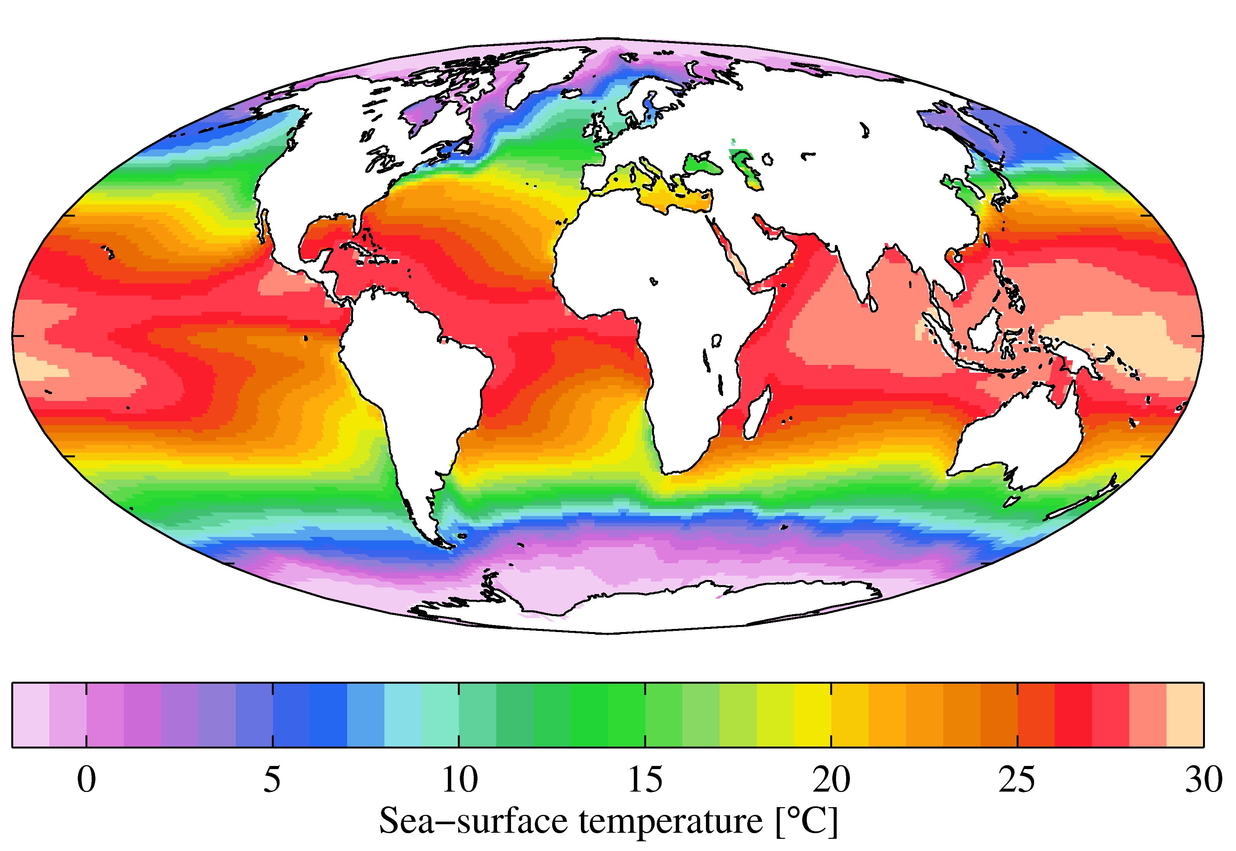
Equatorial Pacific Climatology
Trade wind structure
Piling up pf warm water over west Equatorial Pacific Ocean
Lower sea surface temperature over east equatorial Pacific
Upwelling over east equatorial Pacific
Shallow thermocline over east equatorial Pacific
Deep thermocline over west equatorial Pacific
https://www.google.com/url?sa=i&url=https%3A%2F%2Fcommons.wikimedia.org%2Fwiki%2FFile%3AWOA09_sea-surf_TMP_AYool.png&psig=AOvVaw3gBmKL2Uh9tUKWMZ3OXK6f&ust=1619095839657000&source=images&cd=vfe&ved=0CA0QjhxqFwoTCNjH0ZSwj_ACFQAAAAAdAAAAABAJ

Slide 3
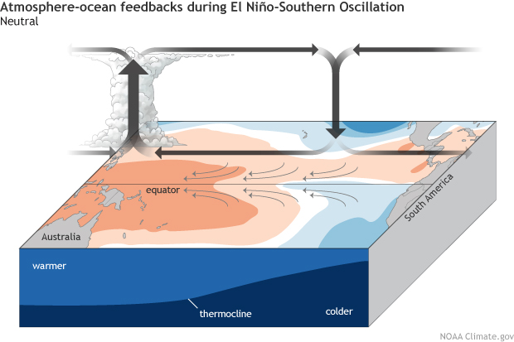
Neutral conditions

Slide 4
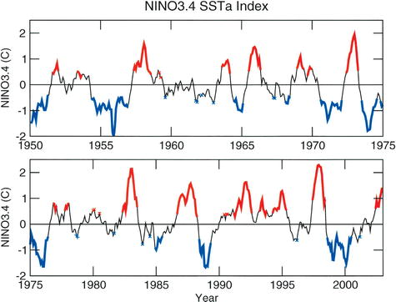
Life cycle of El Niño
https://journals.ametsoc.org/view/journals/clim/18/5/jcli-3277.1.xml

Slide 5
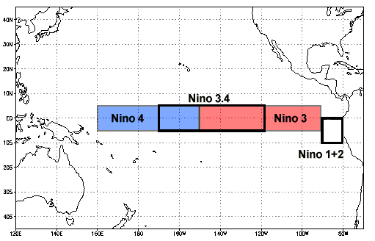
Nino indices
https://www.ncdc.noaa.gov/teleconnections/enso/indicators/sst/

Slide 6
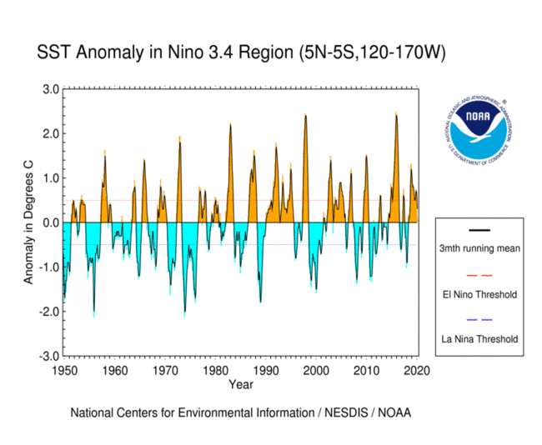
Nino Timeseries
https://www.ncdc.noaa.gov/monitoring-content/teleconnections/eln-f-pg.gif

Slide 7
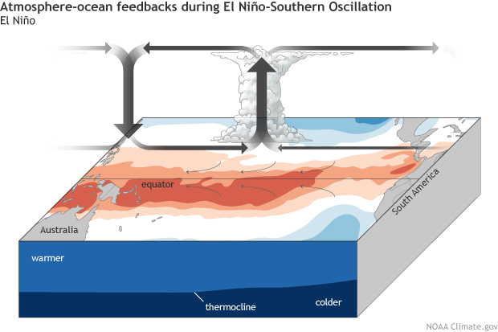
Atmospheric circulation during El Niño
https://www.climate.gov/news-features/blogs/enso/rise-el-niño-and-la-niña

Slide 8
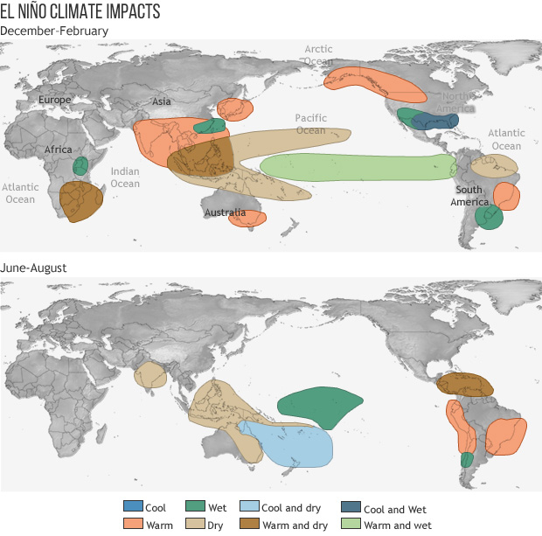
https://www.climate.gov/news-features/featured-images/global-impacts-el-niño-and-la-niña

Slide 9
Ocean models
Introduction to Physical Oceanography – Robert Stewart
Chapter 15
https://www.uv.es/hegigui/Kasper/por%20Robert%20H%20Stewart.pdf

